Slide 1

CM 2602 - Artificial Intelligence
INTELLIGENT AGENTS
< 1 >

Slide 2
Inputs
Reaction
<

Slide 3




Inputs
Environment
Reaction
<

Slide 4
Sensors
Environment
Reaction
<

Slide 5
Sensors
Environment
Actuators
<

Slide 6



Sensors
Environment
Actuators
<

Slide 7
What is an Agent?
An agent is anything that can be viewed as perceiving its environment through sensors and acting upon that environment through actuators.
<

Slide 8
Sensors
Environment
Agent
Actuators
<

Slide 9
Agent
Environment
Sensors
?
Actuators
<

Slide 10

Agent
Environment
Sensors
?
Actuators
Perception - Action Cycle
<

Slide 11
What is a Rational Agent?
A rational agent is one that acts so as to achieve the best outcome or, when there is uncertainty, the best expected outcome.
<

Slide 12
Realistic Definition of Rational Agent
A agent (software) is said to have artificial intelligence if it can interpret data, potentially learn from the data, and use that knowledge to adapt and achieve specific goals.
<

Slide 13
Designing Rational Agents
In designing an agent, the first step must always be to specify the task environment as fully as possible.
We need PEAS (Performance, Environment, Actuators, Sensors) description.
<

Slide 14
AI in Finance:
PEAS (Performance, Environment, Actuators, Sensors)
Stock Market Bonds
Company Profiles
Rates / News
Social Media
Trading Agent
Trades
<

Slide 15
AI in Robotics:
PEAS (Performance, Environment, Actuators, Sensors)
Room Living Area
Pictures
Sounds
Cleaning Agent
Motors
<

Slide 16
Properties of task environment
Fully Observable vs Partially Observable
Deterministic vs Stochastic
Static vs Dynamic
Discrete vs Continuous
Benign vs Adversarial
Episodic vs Sequential
Single agent vs Multiagent
<

Slide 17
Fully Observable Environments
If an agent’s sensors give it access to the complete state of the environment at each point in time, then we say that the task environment is fully observable.
<

Slide 18
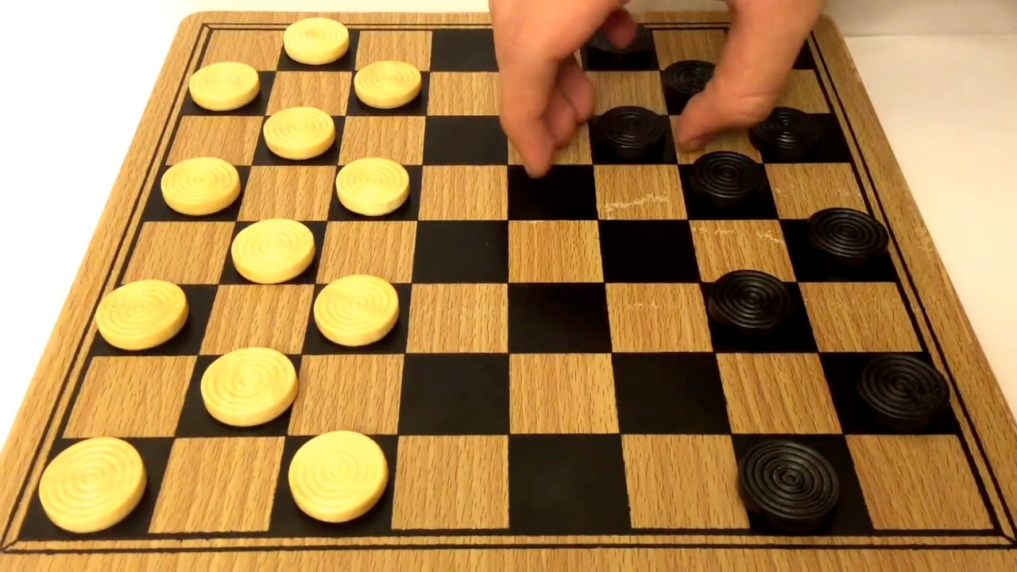
Example of Fully Observable Env
<

Slide 19
Partially Observable Environments
An environment might be partially observable because of noisy and inaccurate sensors or because parts of the state are simply.
In those environments you need memory on the side of the agent to make the best possible decision.
<

Slide 20
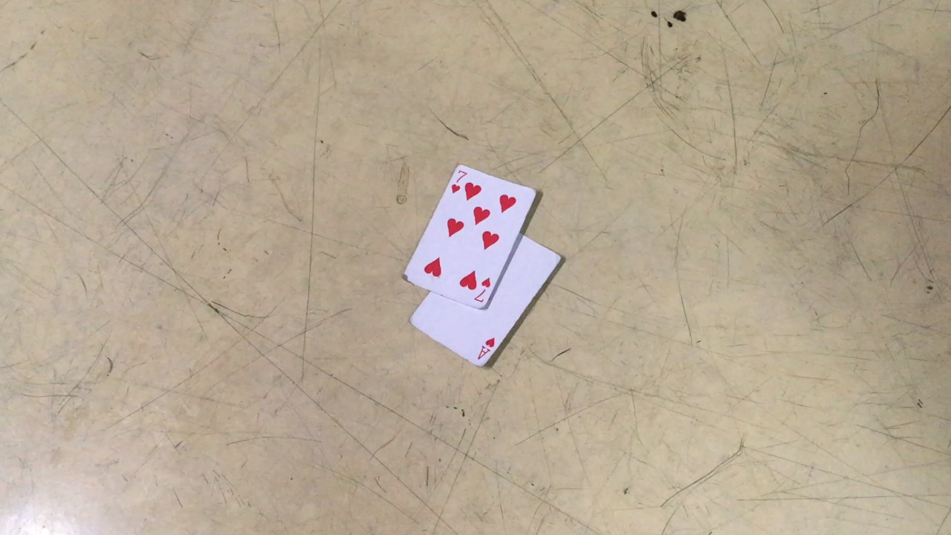
Example of Partially Observable Env
<

Slide 21
Deterministic Environments
If the next state of the environment is completely determined by the current state and the action executed by the agent.
<

Slide 22
Example of Deterministic Env
<

Slide 23
Stochastic Environments
If the next state of the environment is not determined by the current state and the action executed by the agent. There is certain amount of uncertainty involves the next state.
<

Slide 24

Example of Stochastic Env
<

Slide 25
Static Environments
If the environment does not change while an agent is deliberating, then we say the environment is static.
<

Slide 26
Example of Static Env
<

Slide 27
Dynamic Environments
If the environment can change while an agent is deliberating, then we say the environment is dynamic.
<

Slide 28
Example of Dynamic Env
<

Slide 29
Discrete Environments
A discrete environment is one where you have finitely many choices.
<

Slide 30
Example of Discrete Env
<

Slide 31
Continuous Environments
Possible actions or things you could sense may be infinite.
<

Slide 32

Example of Continuous Env
<

Slide 33
Benign Environments
The environment has no objective that would “go against” what you're trying to accomplish.
<

Slide 34
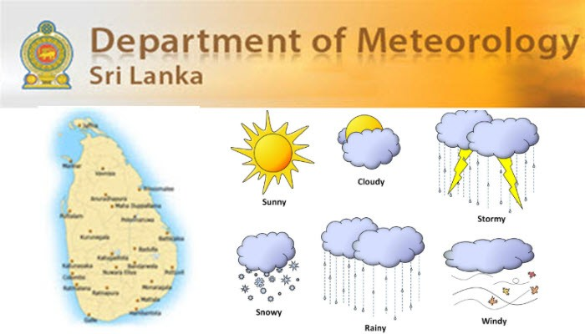
Example Benign Environments
<

Slide 35
Adversarial Environments
The environment observes you and contradict what you're trying to achieve.
<

Slide 36
Example of Adversarial Env
<

Slide 37
Episodic Environments
In an episodic task environment, the agent’s experience is divided into atomic episodes. In each episode the agent receives a percept and then performs a single action.
Crucially, the next episode does not depend on the actions taken in previous episodes.
<

Slide 38
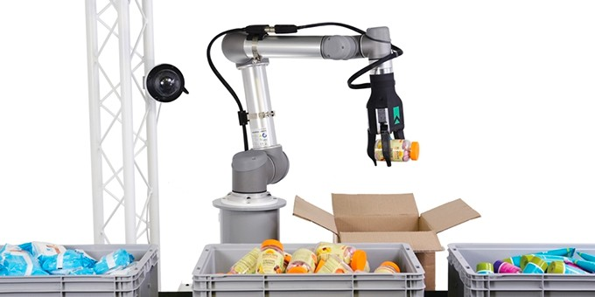
Example Episodic Environments
<

Slide 39
Sequential Environments
In sequential environments, on the other hand, the current decision could affect all future decisions.
<

Slide 40
Example of Sequential Env
<

Slide 41
Single agent environments
If only one agent is involved in an environment, and operating by itself then such an environment is called single agent environment.
<

Slide 42
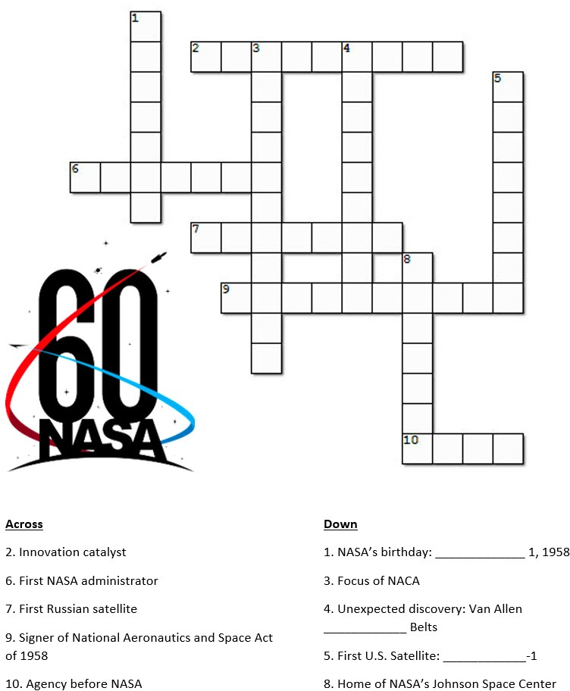
Example of Single agent env
<

Slide 43
Multiagent Environments
If multiple agents are operating in an environment, then such an environment is called a multi-agent environment.
<

Slide 44
Example of Multiagent Env
<

Slide 45
Structure of the Rational Agent
Agent = Architecture + program
Architecture is the machinery that the agent executes on. It is a device with sensors and actuators, for example : a robotic car, a camera, a PC.
Agent program is an implementation of an agent function. An agent function is a map from the percept sequence to an action.
<

Slide 46
Types of Rational Agents
Simple Reflex Agents
Model Based Reflex Agents
Goal Based Agents
Utility Based Agents
Learning Agents
<

Slide 47
Simple Reflex Agents
The simplest kind of agent is the simple reflex agent.
Acts only on the basis of current perception
Ignore the rest of the percept history
Based on the Condition Action Rule
<

Slide 48
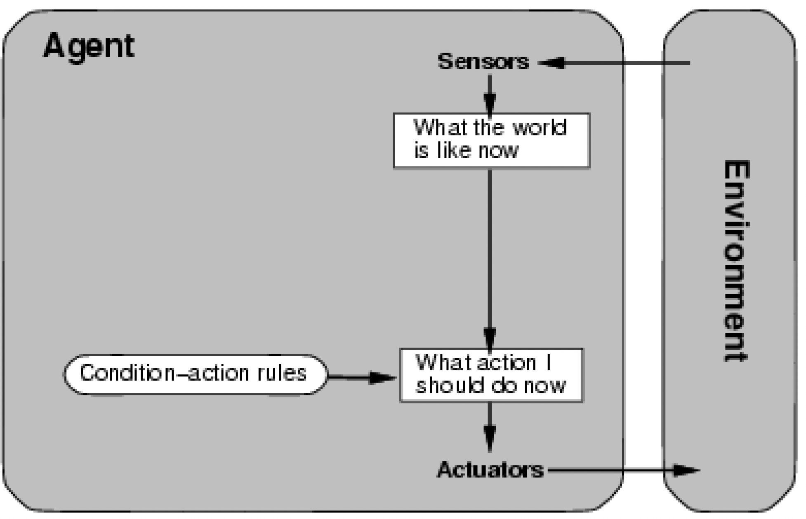
Simple Reflex Agents
<

Slide 49
Simple Reflex Agents: Examples
Tic-Tac-Toe
Checkers Game
Vacuum Cleaner
<

Slide 50
Simple Reflex Agents
Pros:
Simple
Quick
Easy to implement
Cons:
Environment should be fully observable
Limited intelligence
<

Slide 51
Model Based Reflex Agents
Maintain an internal state which is adjusted by each percept
Can be used to handle partial observability by use of a
model about the world
Rule for action depends on both state and percept
<

Slide 52
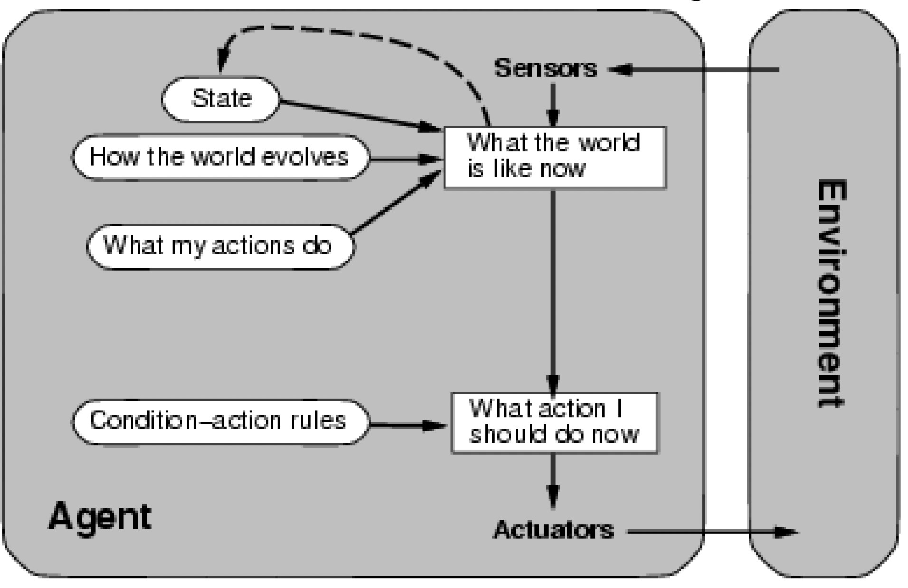
Model Based Reflex Agents
<

Slide 53
Model Based Reflex Agents: Examples
House Cleaning Robot
Mars Lander
<

Slide 54
Model Based Reflex Agents
Pros:
Can work on Partially observable environments
Cons:
Impossible to model the world accurately and reliably
<

Slide 55
Goal Based Agents
Expansion of Model Based Reflex agents.
Decision based on how far they are currently from their goal(description of desirable situations).
Actions are intended to reduce its distance from the goal.
Agent will account for the future
<

Slide 56
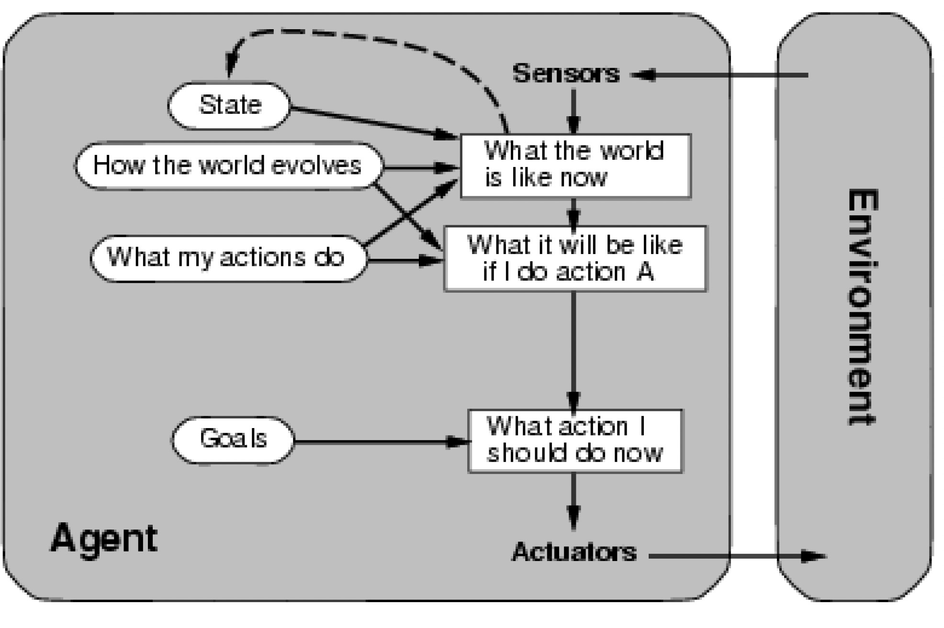
Goal Based Agents
<

Slide 57
Goal Based Agents: Examples
Delivery Agents
Route Finding
<

Slide 58
Goal Based Agents
Pros:
Flexible
Cons:
Need searching and planning
<

Slide 59
Utility Based Agents
Sometimes achieving the desired goal is not enough.
Agent happiness should be taken into consideration.
Utility describes how “happy” the agent is.
A utility function maps a state onto a real number which describes the associated degree of happiness.
<

Slide 60
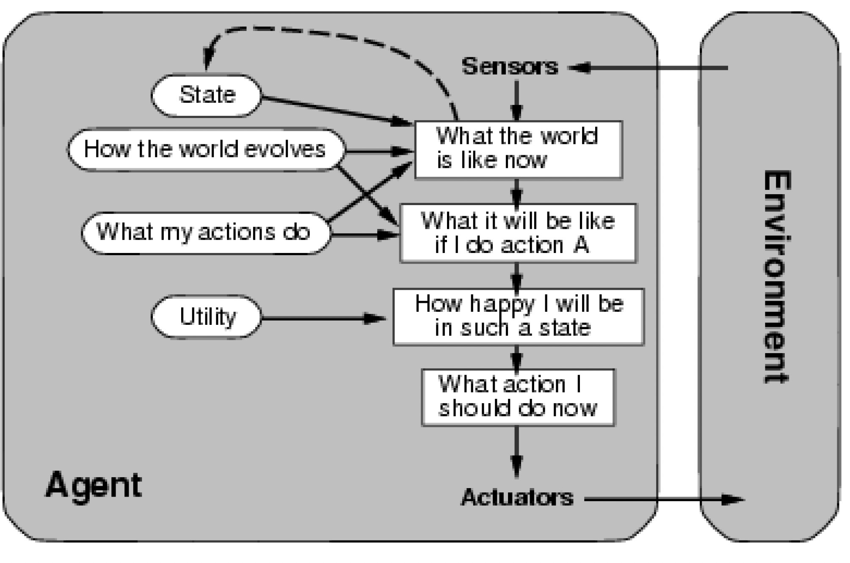
Utility Based Agents
<

Slide 61
Utility Based Agents: Examples
Delivery Agents
Route Finding
<

Slide 62
Utility Based Agents
Pros:
Works on conflicting goals or uncertain goals
Cons:
Utility function
<

Slide 63
Learning Agents
Let the agent figure things out by itself!
Learning element
Makes improvements to performance element
Performance element
Selects actions
Previously this was the whole agent
Critic
Gives performance feedback to learning element
Needed because precepts don’t capture performance
Problem generator
Suggests innovative actions
<

Slide 64
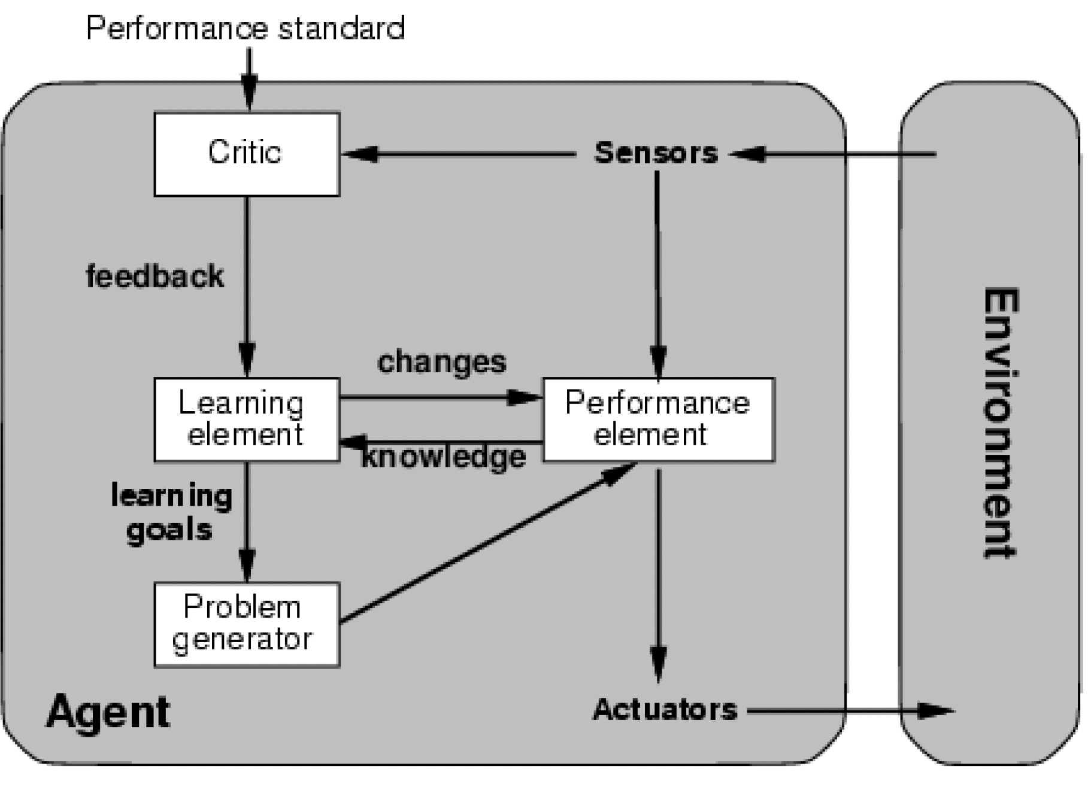
Learning Agents
<

